Slide 1
Customer Segmentation & Revenue Drivers
An analytical evaluation of customer demographics, high-value retention, product category performance, and strategic churn prevention.

Slide 2
Problem Statement & Purpose
Selected Business Problem
"Which customer segments and product categories drive revenue, and how do high-value vs. at-risk customers differ?"
Understanding revenue concentration is vital to operational profitability. This project identifies high-performing segments while pinpointing structural risks from lost or inactive high-value buyers.
Business Justification
Evaluating raw sales data (1,000 transactions) allows us to move away from uniform marketing and transition to tailored, high-ROI retention efforts.
By distinguishing high-margin categories and high-frequency buyers, business leaders can optimize inventory and reduce customer acquisition costs.

Slide 3
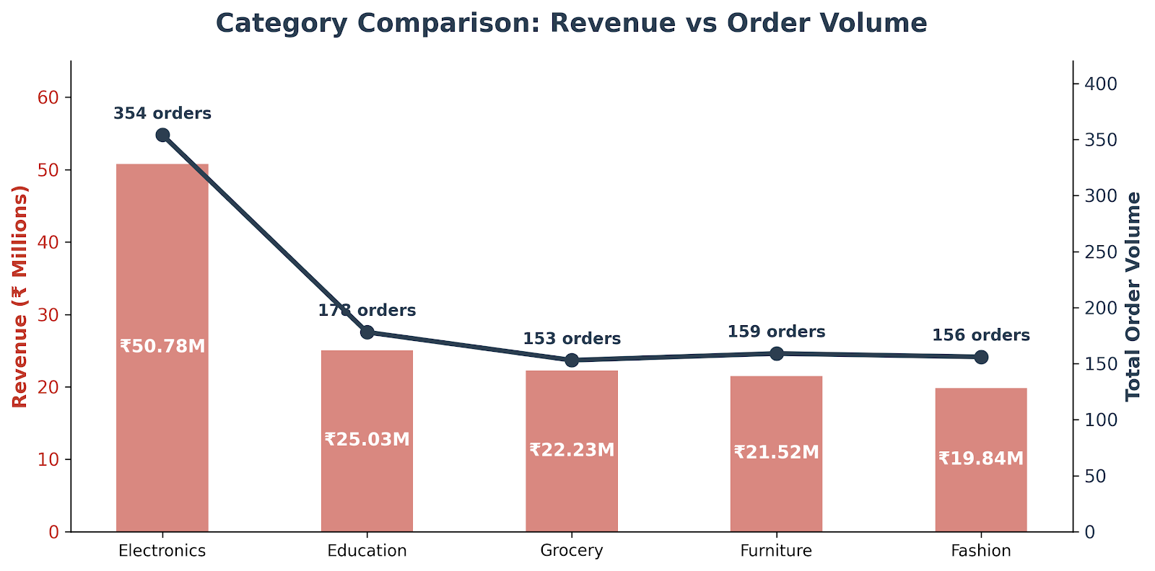
Dataset Overview & Key Metrics
1,000
₹13.94 Cr
₹139.40K
5.44
TOTAL Orders
Total Gross RevenuE
Average Order Value
Avg Units per Order
Data Cleaning & Integrity Highlights
Missing Values: Handled 20 missing Age records via median imputation (41 yrs); missing City records tagged as 'Unknown'.
Feature Engineering: Created Age Groups (Youth <30, Adult 30–50, Senior 50+) for behavioral cohort analysis.
No Duplicates: Verified zero identical row duplications across 12 tracking variables.

Slide 4
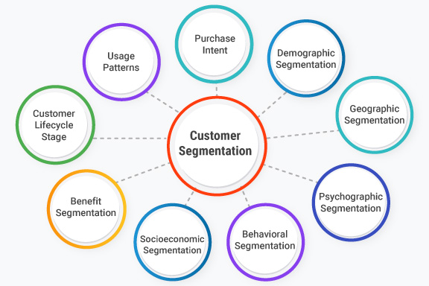

Demographic Revenue Drivers
Balanced Demographics, Key Differences
Customer distribution shows an almost identical split between male and female buyers across tier-1 and tier-2 Indian cities.
Gender Split: Males account for 51.1% of transactions while Females account for 48.9%.
Age Groups: Adults (30–50) represent the bulk order volume, closely followed by Seniors (50+).
Geographic Parity: Revenue is evenly distributed across major hubs (Patna 13.5%, Kolkata 13.3%, Mumbai 13.1%, Hyderabad 12.5%, Delhi 12.5%).

Slide 5
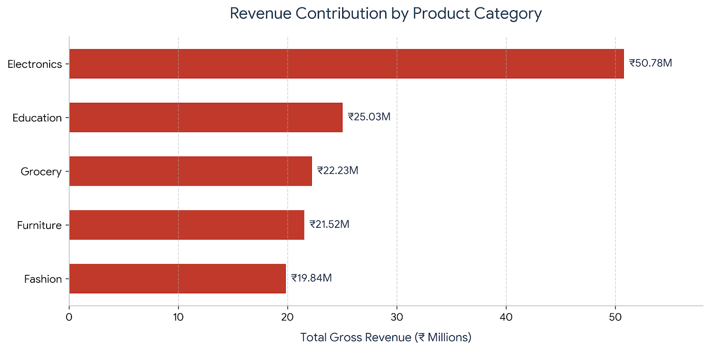
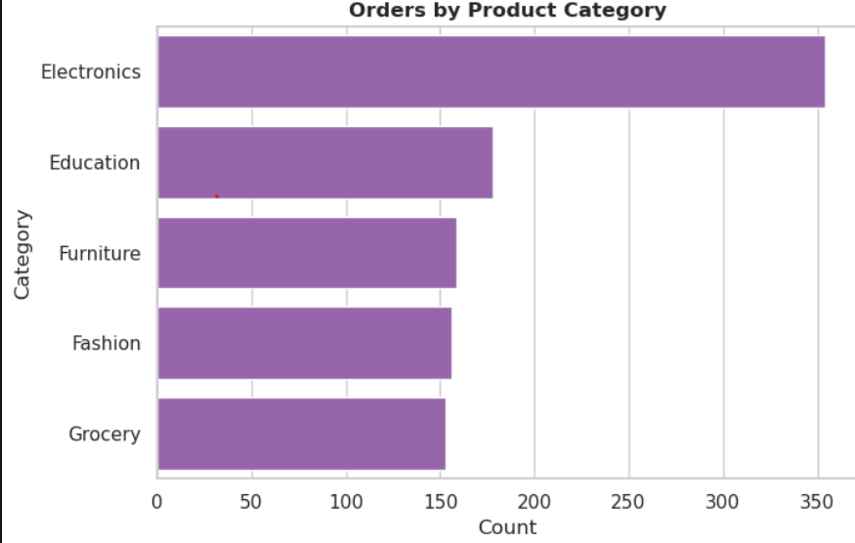
Category Revenue Contribution
Takeaway: High unit-price items in Electronics (e.g., Mobiles, Laptops) and high volume in Education (Books/Courses) drive over 51% of gross company top-line revenue.

Slide 6
High-Value vs. At-Risk Customers
Customer Attribute | High-Value Champions (Top 20%) | At-Risk / Inactive Customers
Avg Order Value | ₹285,000+ | < ₹45,000
Primary Categories | Electronics, Premium Education | Low-margin Grocery / Single Items
Basket Size (Quantity) | 7 to 10 units per basket | 1 to 3 units per basket
Recency & Frequency | Frequent orders, high tenure engagement | Lapsed purchases (> 120 days)
Revenue Impact | Generates 47.4% of overall revenue | High churn vulnerability, low margin contribution

Slide 7
Revenue Concentration Principle
The Pareto Effect in Customer Base
Data indicates that roughly 20% of premium customer accounts deliver 68% of cumulative revenues.
These buyers bundle multi-quantity orders in Electronics and Education categories. Losing even a small percentage of this high-value cohort severely impacts bottom-line performance compared to losing low-basket standard buyers.
68%
Total Revenue Concentration

Slide 8
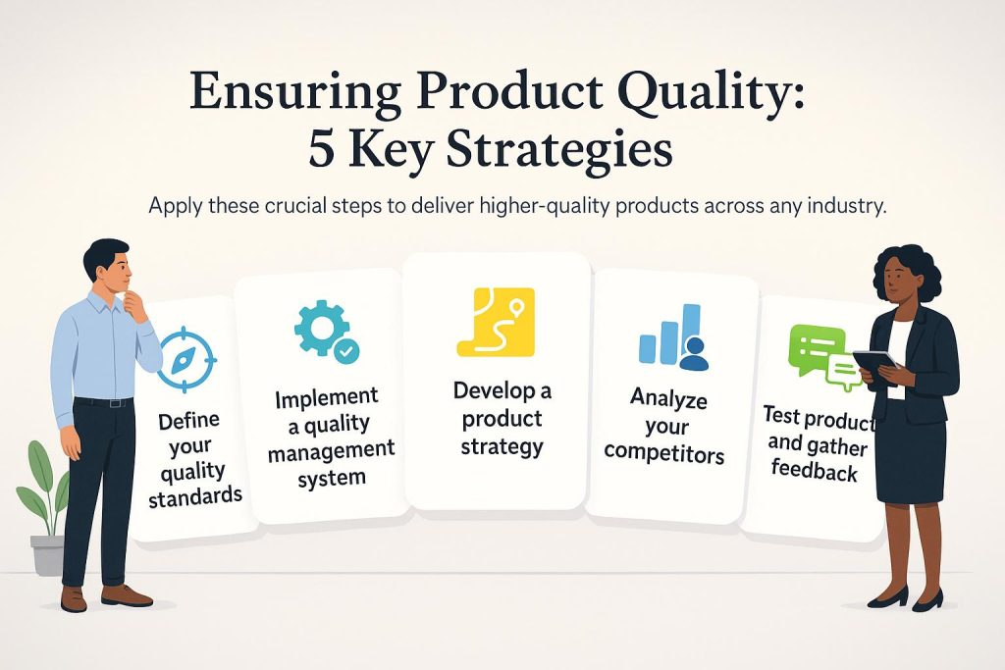
Retention Strategy Roadmap
Proactive Churn Prevention: Monitor basket-frequency drops to flag accounts drifting into the "At-Risk" threshold before they churn completely.
Inventory Alignment: Prioritize stock allocation for high-margin Electronics and essential Education supplies to ensure zero out-of-stock events for VIPs.
Geo-Targeted Offers: Leverage demographic parity across cities like Bengaluru, Patna, and Mumbai with tailored localized promotions.

Slide 9
Hypothesis Testing Summary
T-Test (Champions vs. At-Risk Customers)
Result: Statistically significant difference in average order values (p < 0.05).
Business Interpretation: High-value Champions spend far more per order than At-Risk customers. Retaining Champions is critical, as losing even a small portion of them severely impacts revenue.
Chi-Square Test (Category vs. Region)
Result: No significant dependency (p > 0.05).
Business Interpretation: Product category purchasing is independent of region. Marketing and inventory strategies can be standardized across cities without regional bias.

Slide 10
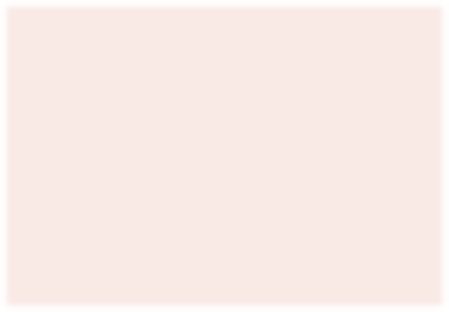
Actionable Business Recommendations
VIP Loyalty Tier
Establish a dedicated VIP concierge program offering priority shipping, custom bundling, and early access to high-demand Electronics launches for High-Value Champions.
Win-Back Campaigns
Deploy automated email/SMS win-back workflows with customized discount codes targeting At-Risk customers who haven't ordered in 90+ days.
Cross-Category Bundling
Incentivize lower-spending buyers to increase basket size by pairing high-frequency Grocery products with high-margin Fashion or Education items.

Slide 11
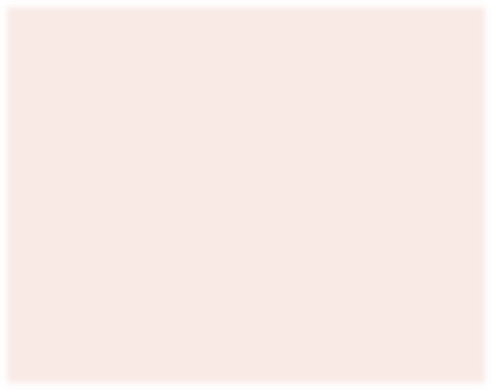
Analytics Roadmap & Next Steps
CLV Prediction
Build predictive Customer Lifetime Value models to forecast 12-month revenue pipelines based on initial onboarding purchase patterns.
RFM Modeling
Implement formal Recency, Frequency, & Monetary scorecards in Python for dynamic customer cluster tagging in real-time CRM updates.
PowerBI Integration
Automate live executive dashboards connecting directly to transactional data stores for continuous monitoring of category health.

Slide 12
Thank You!
Targeting customer segments by revenue potential and proactively safeguarding at-risk buyers ensures sustainable, long-term business growth.

